Slide 1


2025 Sales Report Analysis
Analyzing Amazon’s sales data for the first quarter of 2025(January – March) and developed an interactive dashboard to visualized the insights the dashboard highlights the following:
Category wise total sales
Total sales by Payment method
Total sales by Product
Total sales by customer location

Slide 2
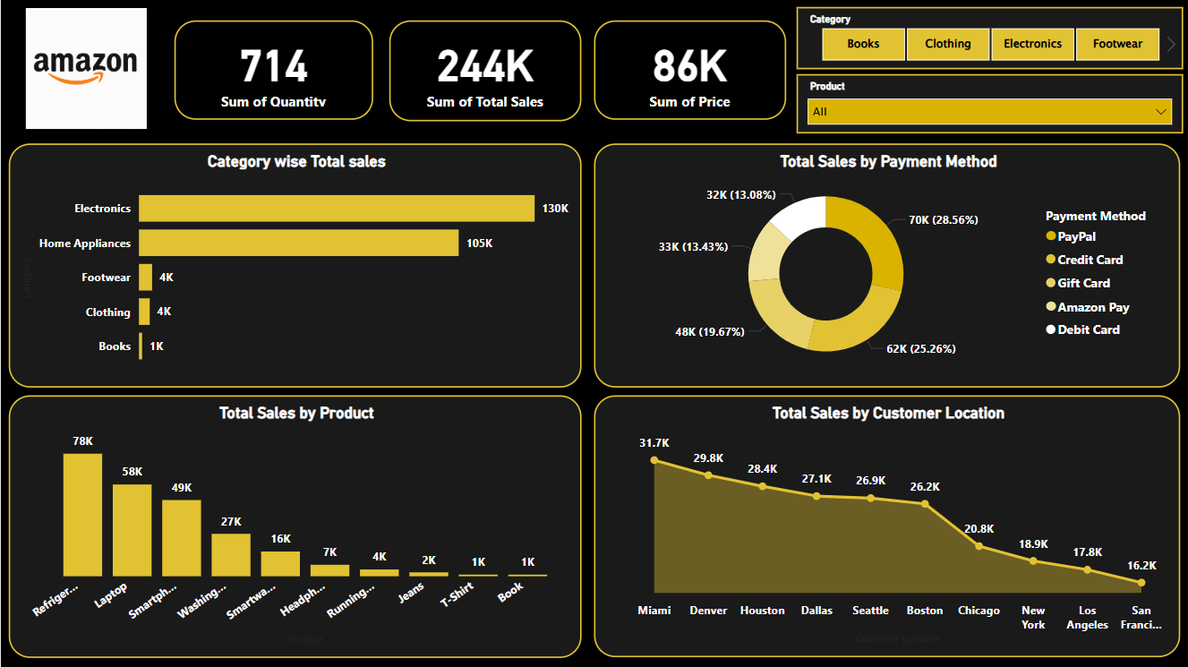
2025 Sales Report Analysis
Analyzing Amazon’s sales data for the first quartor of 2025(January – March) and developed an interactive dashboard to visualized the insights the dashboard highlights the following:

Slide 3
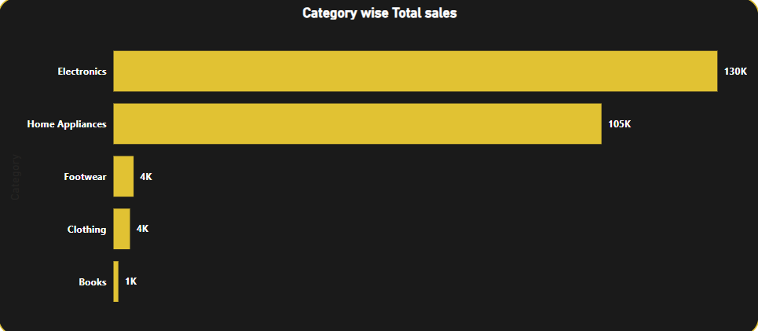
Category wise Total sales
This graph represents the category wise sales (Electronics, Home appliances, footwear, clothing & books) as mention above, according to the analysis in the first quarter of the sales Electronics has the highest sales of around 130k following Home appliances has the second highest sales of 105k.

Slide 4
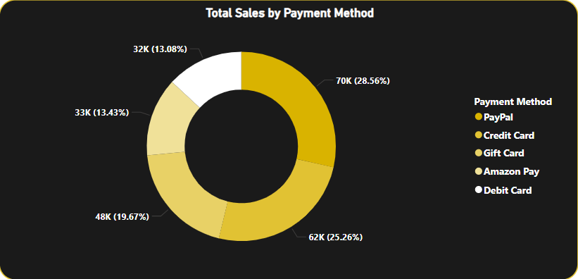
Total sales by payment method
This graph represents the most preferred payment method in amazon in the last 3 months and according to the analysis we can say that Pay Pal (online payment mode) is the most used payment method over 70k (28.56%) of people preferred to pay with Pay Pal.

Slide 5
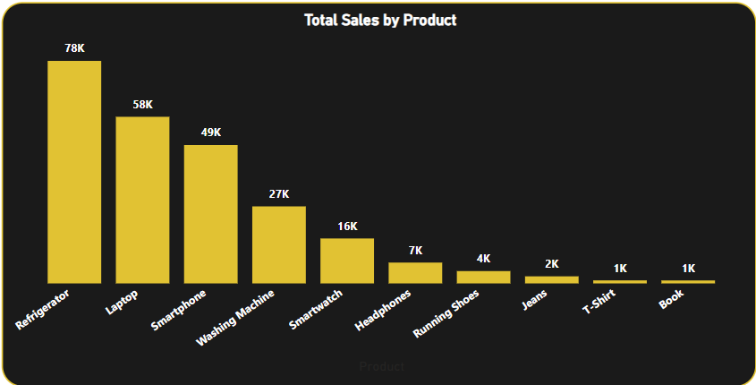
Top selling products
This graph represents the top selling products in the last 3 months in amazon according to the analysis we can see that Refrigerator, Laptop & Smartphones has got the highest sales of around 78k, 58k & 49k respectively.

Slide 6
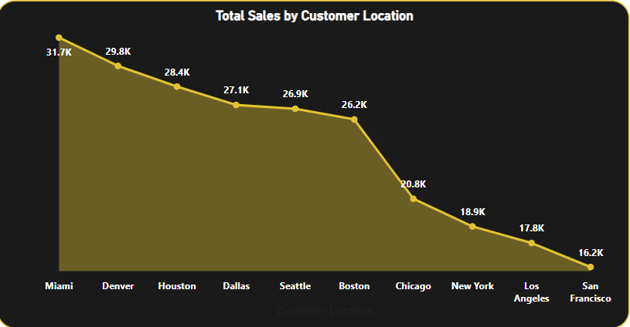
Customers location wise sales
This graph represents the location wise sales of the last quarter in amazon, according to the analysis Miami has the highest sales of around 31.7k in the last 3 months following to the highest sales Denver has the second highest sales of around 29.8k.

Slide 7
Thank you for watching

